Slide 1
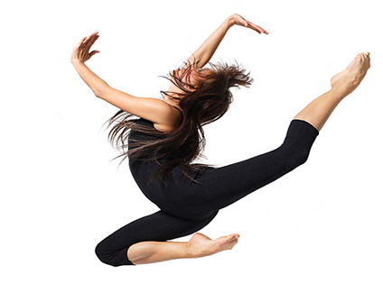
LESSON 6
YEAR 9 DANCE
DANCE SKILLS UNIT .

Slide 2

LONG TERM OBJECTIVES
explore and develop your dance skills and review your own practice
use your dance skills within rehearsal and performance.

Slide 3
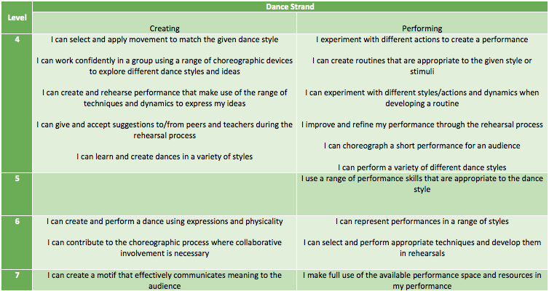
SUCCESS CRITERIA

Slide 4
RECAP ALL OF THE KEY WORDS YOU HAVE LEARNT SO FAR.

Slide 5
KEY WORDS
RETROGRADE
MOTIF
LIFTS

Slide 6
TIME TO WARM UP ☺

Slide 7
CHOREOGRAPHY TIME
GET YOURSELVES INTO GROUPS OF 4.
IN YOUR GROUPS YOU NEED TO CHOREOGRAP THE END SECTION OF YOUR ROUTINE. IT MUST INCLUDE:
RETROGRADE
LEVELS
FORMATIONS

Slide 8
REHEARSE, REHEARSE REHEARSE

Slide 9
PLENARY
WHAT DOES CHOREOGRAPHY MEAN?
HOW HAVE YOU USED THE KEY WORDS IN YOUR LESSON TODAY?
WHAT DO YOU FEEL HAS GONE WELL TODAY?
WHAT DO YOU FEEL YOU COULD IMPROVE ON?

